Slide 1
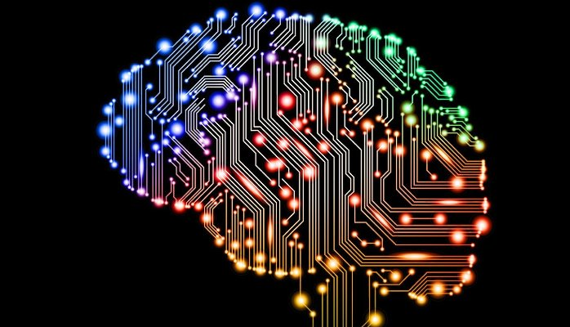
Data Science and Machine Intelligence IN726001
Lecturer: David Rozado
Notes:
This course strives to teach you state-of-the-art machine learning techniques that are routinely used to make computers mimic some capabilities of the human brain such as image/sound perception, anomaly detection, clustering, pattern recognition and inference.

Slide 2
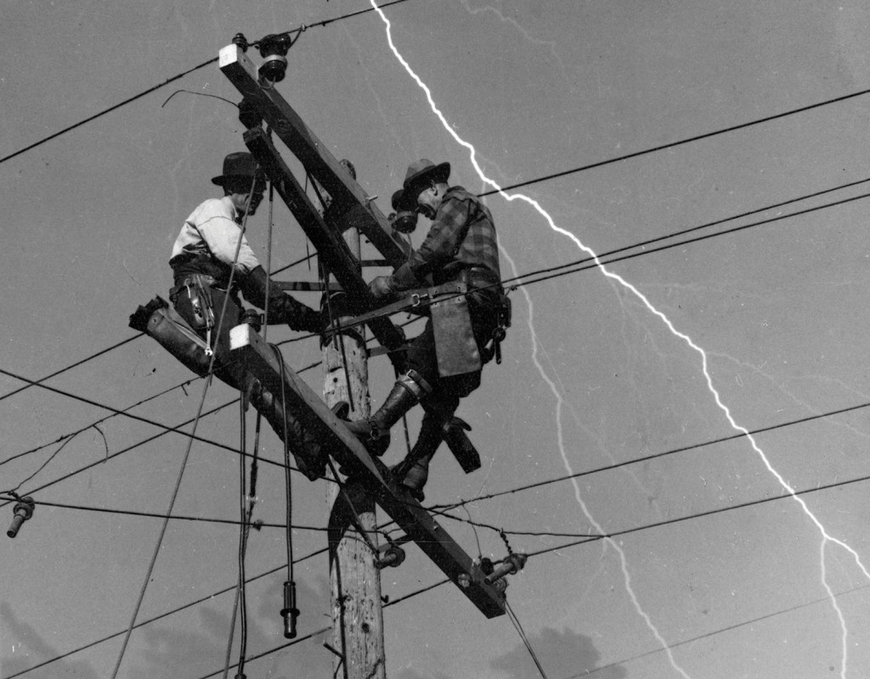
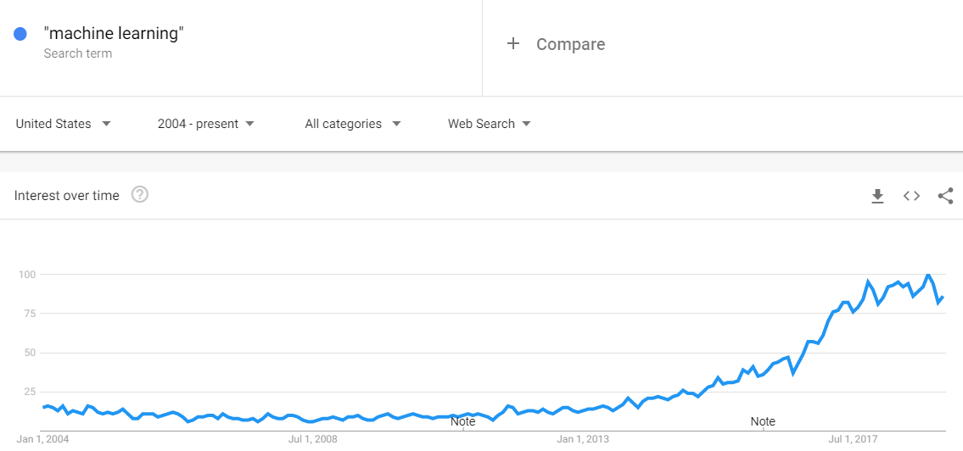
Preamble
In the past few years, the terms Artificial Intelligence (AI), machine learning and deep learning have been the subject of intense media hype.
We are being promised a future of intelligent chatbots, self-driving cars, and virtual assistants
A future sometimes painted as an utopia and sometimes as a dystopia
Some people even argue that AI is the new electricity
As future IT professionals what are you suppose to make out of all this noise?
Notes:
In the past few years, the terms Artificial Intelligence (AI), machine learning, deep learning have been the subject of intense media hype.
We are being promised a future of intelligent chatbots, self-driving cars, and virtual assistants—a future sometimes painted as an utopia or a dystopia
Some people even argue that AI is the new electricity
Starting about 100 years ago, the electrification of our society transformed every major industry, every ranging from transportation, manufacturing, to healthcare, to communications and many more
Will AI might bring about an equally big transformation?

Slide 3
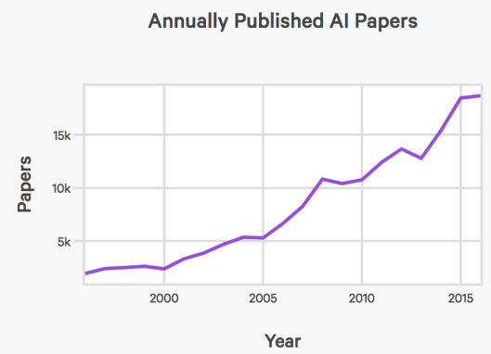
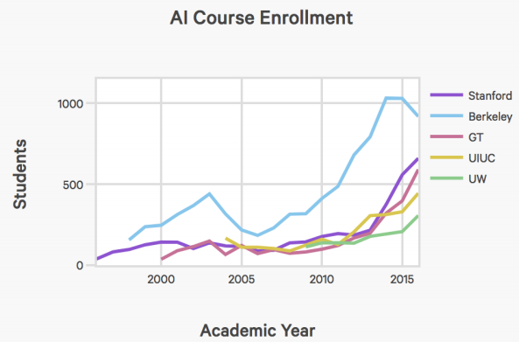
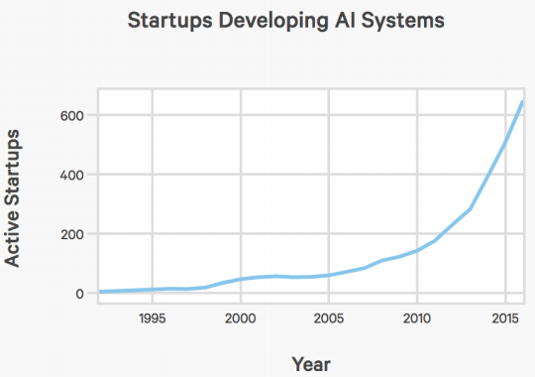
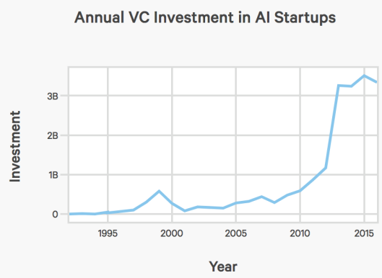
Empirical evidence about the growing relevance of machine learning

Slide 4
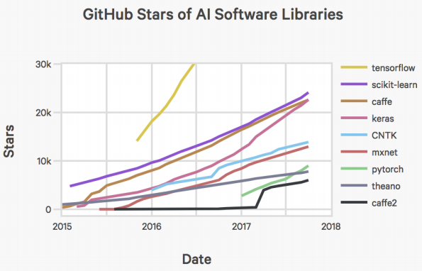
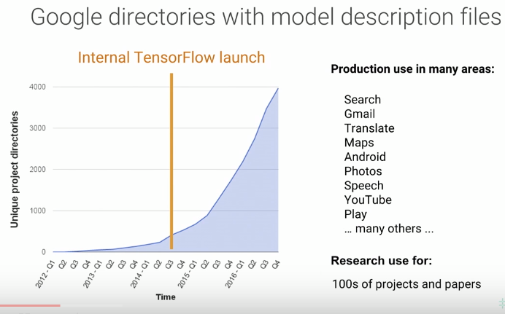
Empirical evidence about the growing relevance of machine learning
Google directories using machine learning models
Notes:
This figure shows the usage of machine learning models at Google over time

Slide 5
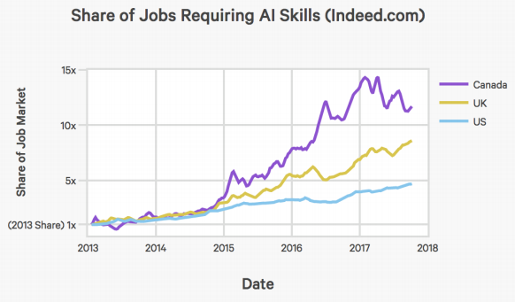
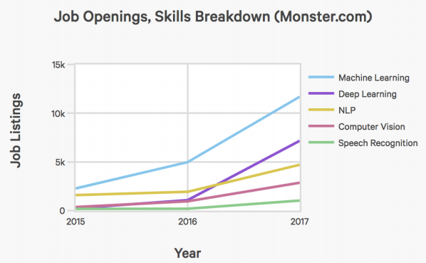
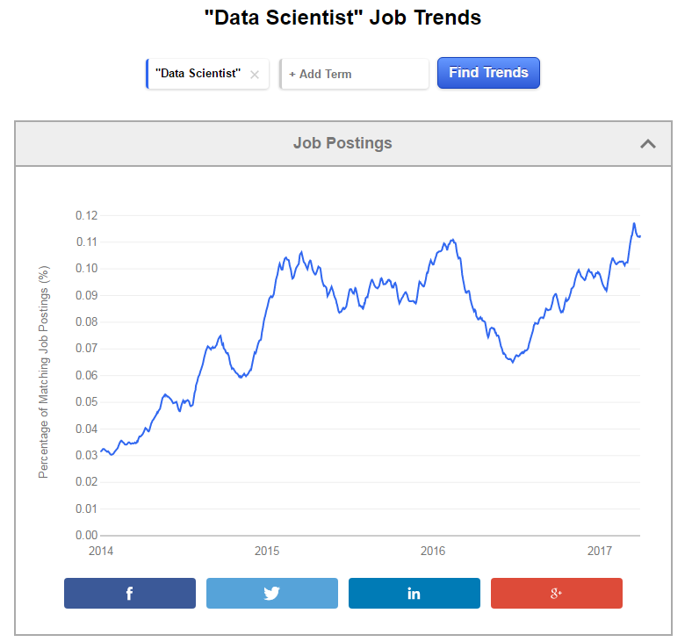
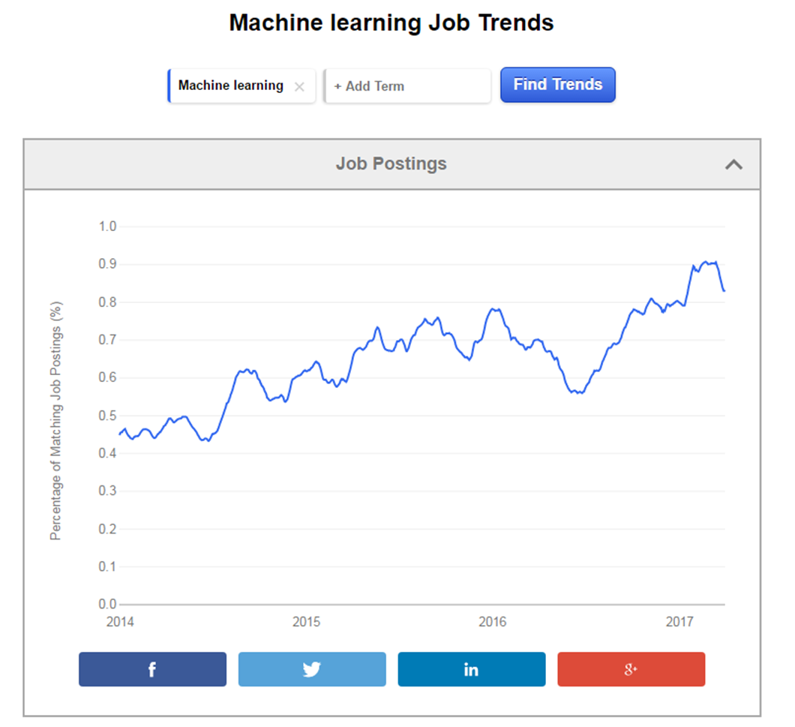
The AI hype/disruption is having real effects on the economy
https://www.indeed.com/jobtrends
Notes:
Therefore, there seems to exists robust industry demand for skilled workers having competency in:
Data analytics
Machine learning
Big data
Data science
AI
Deep learning

Slide 6
So what’s going on?
Is this something truly significant or is it just a fad?
As future IT professionals, it is important that you are able to make informed decisions and learn to recognize the signal within the noise
That is, to tell apart world-changing developments from what are merely over-hyped press releases.
What has machine learning really achieved so far? How significant is it? Where are we headed? Should you believe the hype?

Slide 7
What is Artificial Intelligence (AI)?
Artificial Intelligence: Advanced digital technologies that enable machines to reproduce or surpass abilities that would require intelligence if humans were to perform them.
It is important to distinguish between Narrow and General AI.
Narrow AI performs a specific task, for example, playing a game (like Go or Chess), engaging with customers to provide customer service responses or analysing MRI scans to support a doctor’s diagnosis.
All current AI working systems today are considered Narrow AI.
General AI is the (as yet theoretical) scenario where a machine could successfully perform any intellectual task as well as, or better than, a human.
There is much debate as to when, if ever, human level General AI may be achieved.
Today, most AI hype focuses on Narrow AI applications

Slide 8

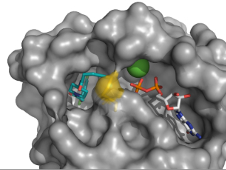
Why should computers “Learn” (i.e show intelligent behavior)
Mainly to automate tasks
That humans cannot do
OR
That humans do suboptimally
For instance:
Reduce costs by automation (Speech recognition, Image recognition, assembly line, driving, security monitoring)
Eliminate tedious or dangerous work ( mining)
Human expertise does not exist (Navigating on Mars, Drug pharmacokinetics prediction at the molecular level
Human performance is suboptimal (Medical diagnosis, making sense of vast amounts of data)
Solution changes in time too fast for a human to keep up (Routing on a computer network, algorithmic trading in the stock market,…)
Optimize processes to particular cases where there is not enough human capital to do the work (Personalized medicine)

Slide 9
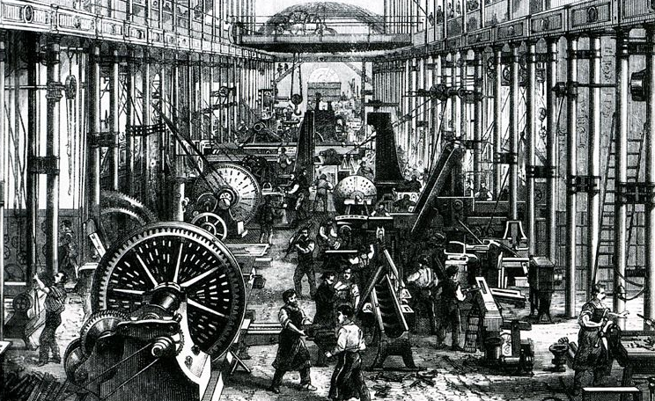
What is the societal impact of progress in machine intelligence?
Think about the social impact of machines substituting humans for cognitive work
Previously in history (Industrial Revolution), machines substituted human labor that carried out physical work
Certain jobs were destroyed in the process
But new jobs emerged (there was no personal trainers or sustainability officers 200 years ago)
What will happen if machines become truly intelligent and are able to out match humans in cognitive tasks?
Imagine a machine learning powered robotic Doctor
Or an AI based lawyer
What would be the social ramifications of such technological development?
Good or bad?
Are we prepared for such a world?

Slide 10
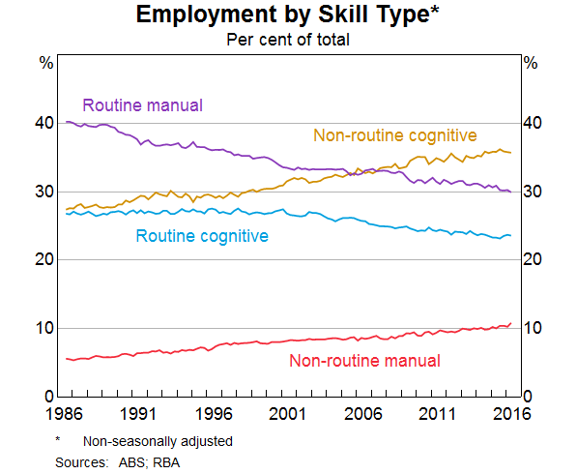
What type of jobs are at risk due to Automation?
Occupational share of US employment by skill type

Slide 11
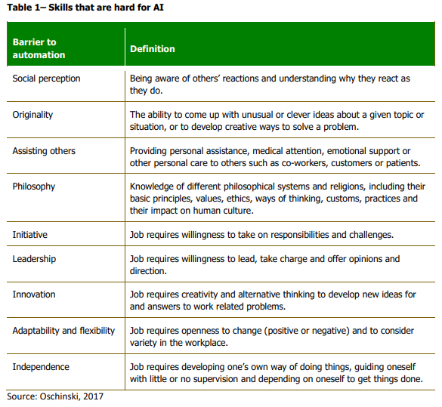
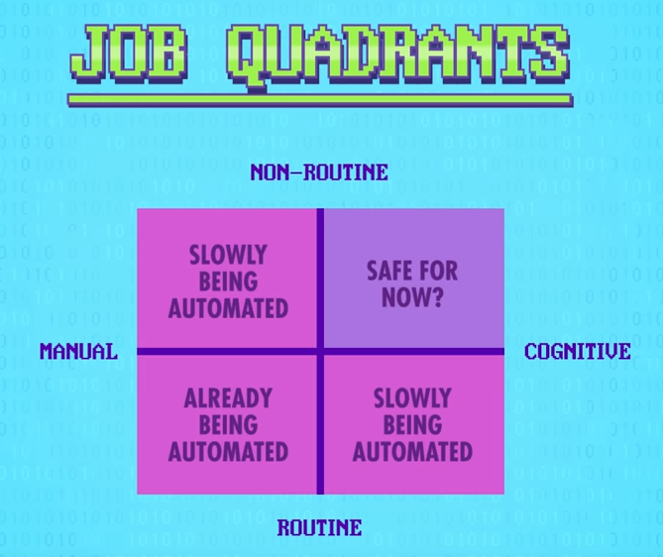
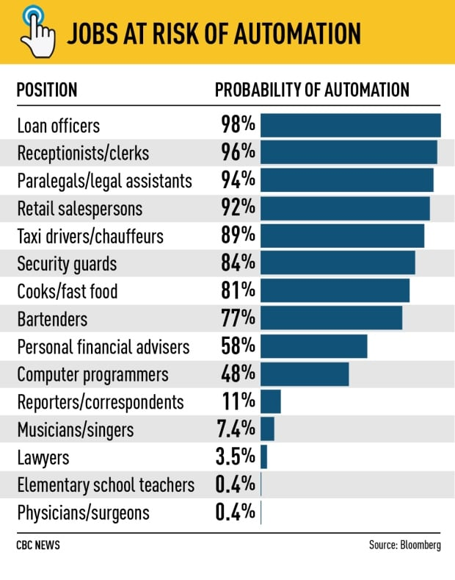
The types of tasks where humans are expected to have enduring cognitive advantages over computers tend to be described as ‘non-routine’ and include creativity, initiative, leadership and empathy

Slide 12
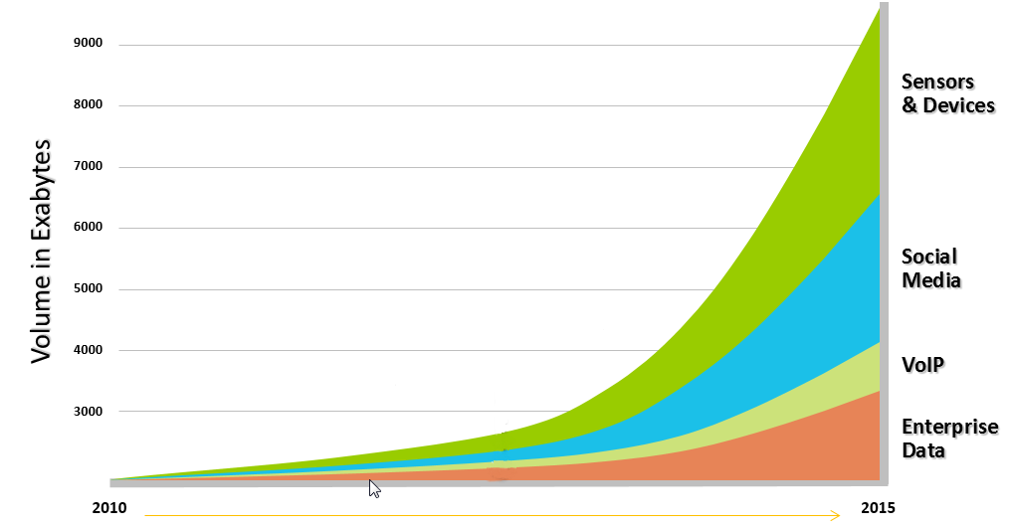
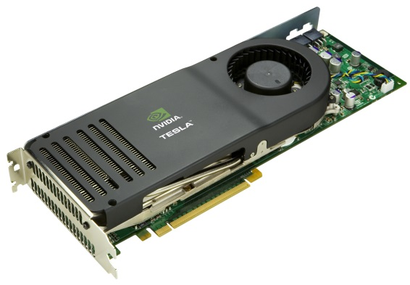
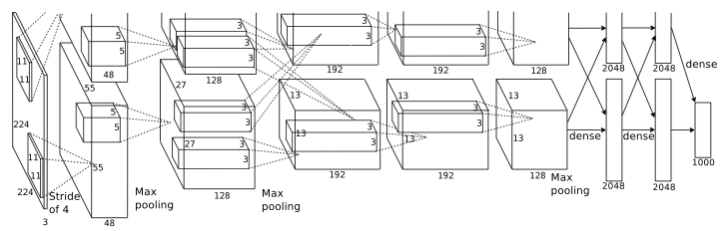
Why has machine learning become very relevant recently? Mainly due to the confluence of 3 factors
More data is being generated than ever before (Data flood):
Digitalization of information
Banking
Telecommunications
Media
...
Sensor networks
Scientific data: astronomy, biology, sociology
Web
Advances in hardware provide increased computational capability
GPUs
Theoretical breakthroughs
Deep learning
Notes:
Not only the amount of data being collected is getting larger, the complexity of this data is also increasing by leaps and bounds!

Slide 13
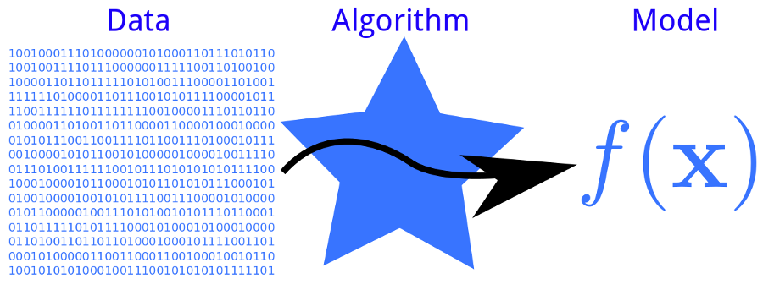

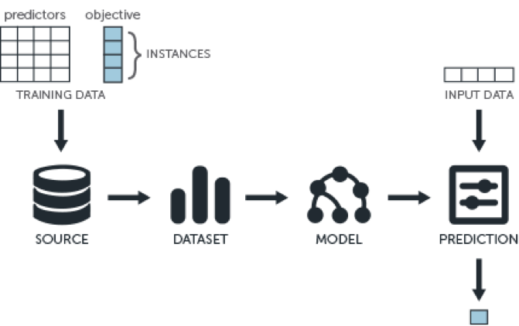
Today, social institutions (companies, government agencies, NGOs, scientific labs, etc) collect large amounts of data
What can be do with all that data?
Raw data
Core idea of machine learning:
learning from data → So predictions can be made
Query
?
The potential to analyse such data, and make better decisions/predictions based on the outcome of the analysis or to automate data dependent processes is one of the main motivations for the usage of AI tools
Answer

Slide 14


Why can learning be actually achieved?
We can not learn anything about the world, if there would not be structure in the universe
What is structure? Patterns, regularities, motifs, schemes, plans, configurations, formats, congruities, orders, periodicities, recurrences, rhythms…

Slide 15
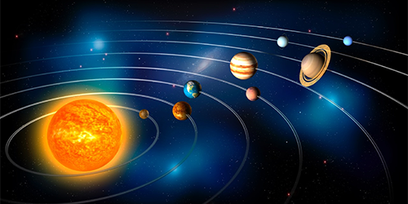
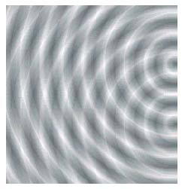
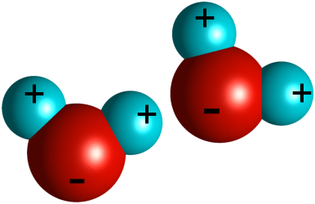
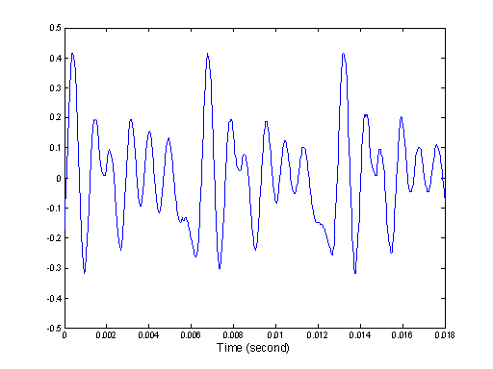

What are Patterns?
Physical Laws that govern the functioning of the universe generate patterns
Physics, chemistry, optics,…

Slide 16
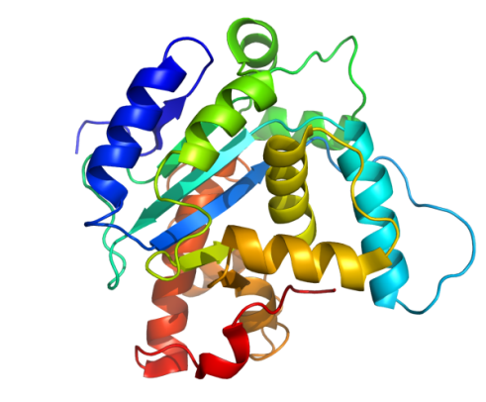
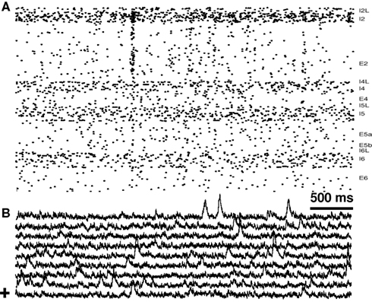

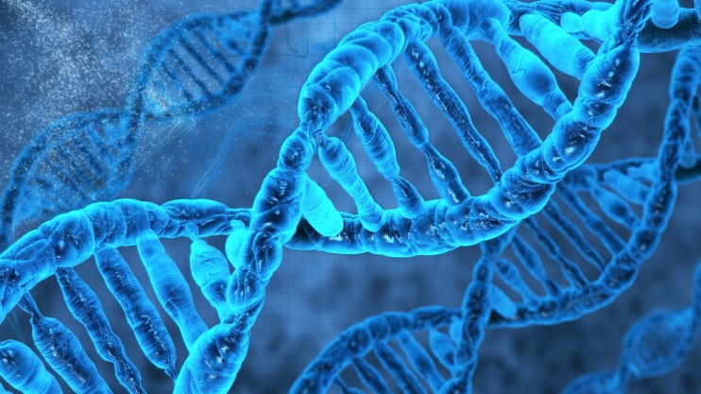
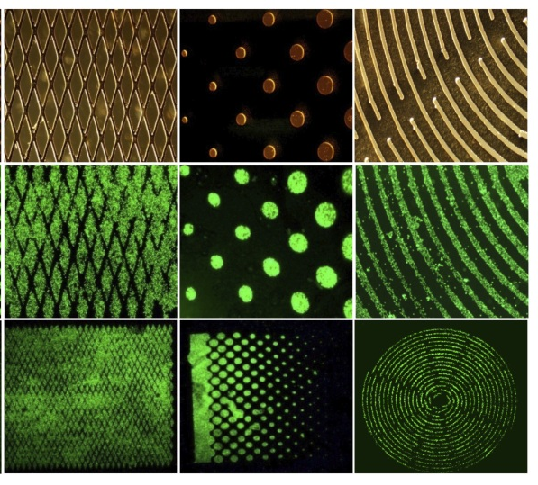
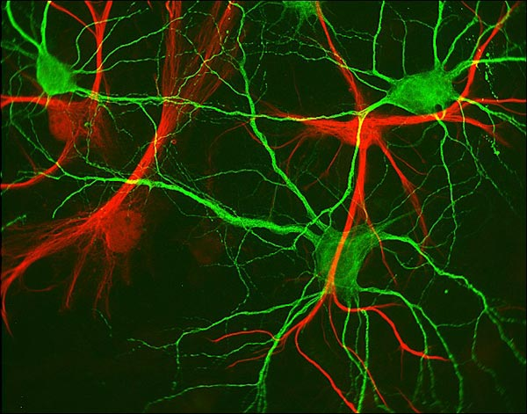

Patterns in Biology

Slide 17
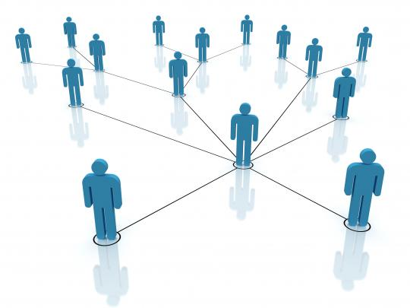
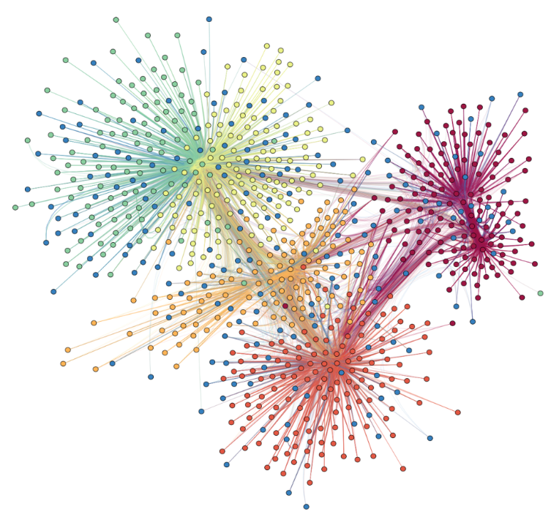
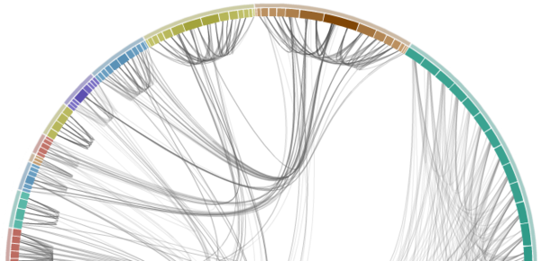
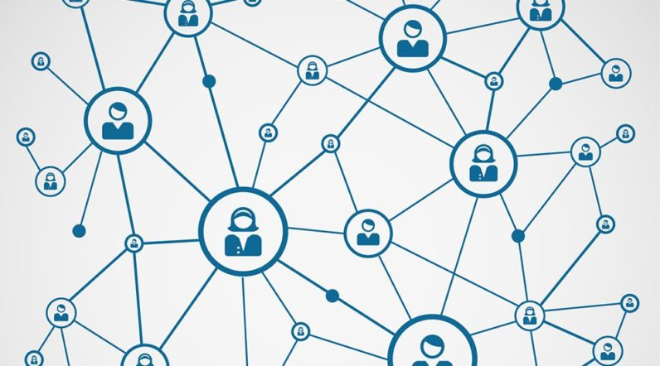
Patterns in Social Phenomena

Slide 18
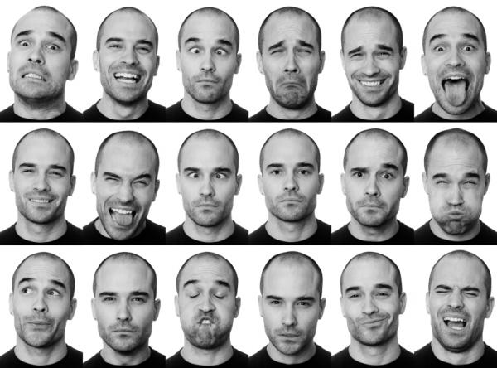
Patterns are all around us
Humans signal emotions through facial expression patterns

Slide 19
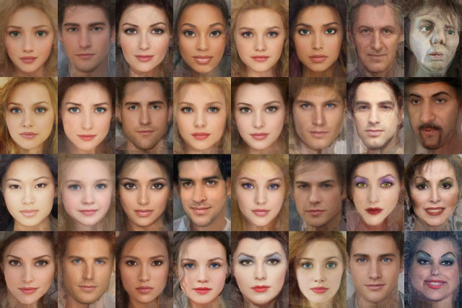
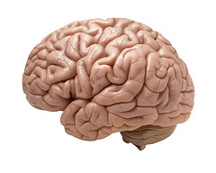

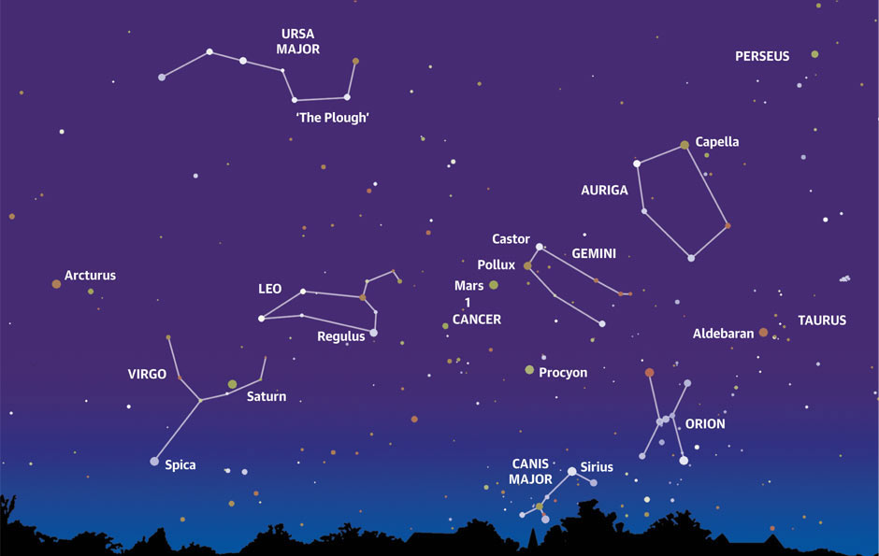
The human brain as a pattern recognition engine
The human brain is exceptionally good at certain types of pattern recognition
Facial recognition
Speech recognition
Locomotion
However, often humans are unable to explain their expertise in many skills
Speech recognition
Image recognition
Automatic pattern recognition classifiers (machines) don't match (yet) several metrics of brain performance
But they are converging in many
Humans tend to detect patterns everywhere (occasionally even overfitting→cognitive bias)
This perhaps lies at the root origins of many social phenomena
Religion, ideology, conspiracy theories,…
Notes:
The human brain seems to have been optimized by evolution to detect patterns in its environment. This is probably due to the fact that the ability to accurately assess information about the surroundings and detecting relevant patterns ( predators, mating partners, etc.) provided a huge evolutionary advantage. The brain is so tune at detecting patterns that sometimes it even wants to find patterns when none exists. That is, it is highly unlikely that the creator of the universe arranged stars on the firmament so they resemble animals, yet ancient humans would look at the sky at night and notice such patterns. This is related to a technical term that we will visit later in the course call overfitting. We humans have a tendency to overfit our previous experience (training data) into patterns and regularities that sometimes simply ain’t so. That being said, the human brain is still a remarkable pattern recognition engine, even if it occasionally fails us.

Slide 20
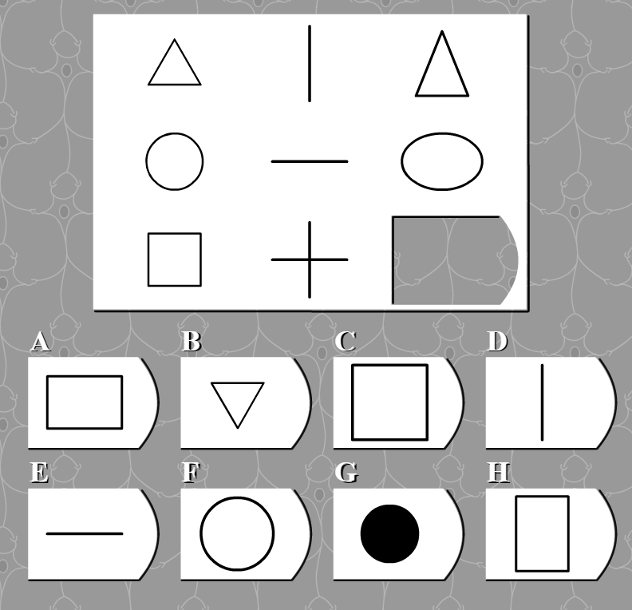
What is intelligence?
Long definition: “A very general mental capability that, among other things, involves the ability to reason, plan, solve problems, think abstractly, comprehend complex ideas, learn quickly and learn from experience. It is not merely book learning, a narrow academic skill, or test-taking smarts. Rather, it reflects a broader and deeper capability for comprehending our surroundings—"catching on," "making sense" of things, or "figuring out" what to do”
an op-ed statement in the Wall Street Journal signed by fifty-two researchers (out of 131 total invited to sign)
Short definition: The ability to recognize patterns
Hierarchy of patterns in the universe
Simple patterns
Complex patterns
Wellington is to New Zealand as Berlin is to…
Complex patterns
Simple patterns

Slide 21
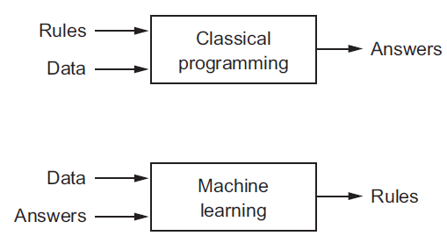
Symbolic AI versus data-driven AI
Artificial intelligence was born in the 1950s, as a handful of pioneers from the nascent field of computer science started asking if computers could be made to "think"—
A concise definition of the field would be: the effort to automate intellectual tasks normally performed by humans.
AI is a very general field which encompasses machine learning, but also includes many more approaches that do not involve any learning.
Early chess programs, for instance, only involved hard-coded rules crafted by programmers, and did not qualify as "machine learning".
In fact, for a fairly long time many experts believed that human-level artificial intelligence could be achieved simply by having programmers handcraft a sufficiently large set of explicit rules for manipulating knowledge.
This approach is known as "symbolic AI", and it was the dominant paradigm in AI from the 1950s to the late 1980s.
Although symbolic AI proved suitable to solve well-defined, logical problems, such as playing chess, it turned out to be intractable to figure out explicit rules for solving more complex, fuzzy problems, such as image classification, speech recognition, or language translation.
A new approach to AI arose to take its place: machine learning (data driven AI).
Rather than crafting data-processing rules by hand, automatically learn these rules (i.e. statistical structure) by looking at data
Symbolic AI
Data driven AI

Slide 22

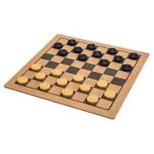
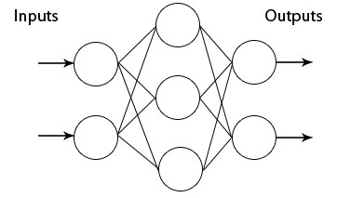
A brief history of AI milestones
1950 — Alan Turing publishes “Computing machinery and intelligence” paper. Defines the “Turing Test” to determine if a computer has real intelligence. To pass the test, a computer must be able to fool a human into believing it is also human
1952 — Arthur Samuel wrote the first computer learning program. The program was the game of checkers, and the computer improved at the game the more it played, studying which moves made up winning strategies and incorporating those moves into its program
Considerable amount of optimism in the scientific community about computers soon achieving enough artificial intelligence to recognize images, sounds, robotic movement etc. using a symbolic approach
1956 — Scientist John McCarthy coined the term “artificial intelligence” for the Dartmouth conference.
1957 — Frank Rosenblatt designed the first artificial neural network for computers (the perceptron), which loosely “simulates” the neural connections of the human brain

Slide 23
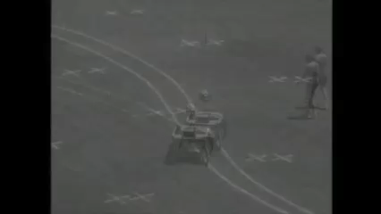
A brief history of AI milestones
1959 —Scientist Arthur Samuel coined the term “machine learning”.
1967 — The “K-nearest neighbors” algorithm was written, allowing computers to begin using very basic pattern recognition. This could be used to map a route for traveling salesmen, starting at a random city but ensuring they visit all cities during a short tour
1973 — The first "AI winter“ sets in as interest in AI decreases and funding dries up
1979 — Students at Stanford University invent the “Stanford Cart” which can follow a line on the floor

Slide 24
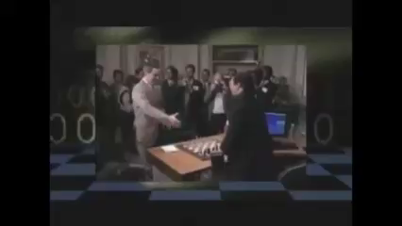
A brief history of AI milestones
1986s — Bundeswehr University in Munich develops the first selfdriving car.
1987 — The second "AI winter" begins.
1990s — Work on machine learning shifts from a logic/knowledge-driven approach (symbolic) to a data-driven approach
Scientists begin creating programs for computers to analyze large amounts of data and draw conclusions — or “learn” — by themselves from the results
1997 — IBM’s Deep Blue beats Garry Kasparov the world champion at chess
Notes:
1950s – 1980s: achieve artificial intelligence by having programmers handcraft a sufficiently large set of explicit rules for manipulating knowledge ( symbolic AI) and carrying out deduction
-Well suited to solve well defined, logical problems, such as playing chess
-Hopeless for solving more complex, fussy problems, such as image classification, speech recognition or language translation
Shift in paradigm: Let the data do the work instead of programming the rules (1990s…)
-Learning general models from data of particular examples
-Extrapolate from a given set of examples to make accurate predictions about future examples (induction)

Slide 25

A brief history of AI milestones
1990s — kernel methods: Vladimir N. Vapnik et al suggested a way to create nonlinear classifiers by applying the kernel trick to maximum-margin hyperplanes and find good decision boundaries:
Support Vector Machines (SVMs)
Simple idea that works great
In 2000s became the state of the art in machine learning for numerous problems
1998s —NASA’s Remote Agent is first fully autonomous program to control a spacecraft in flight

Slide 26
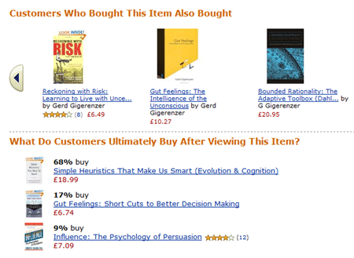
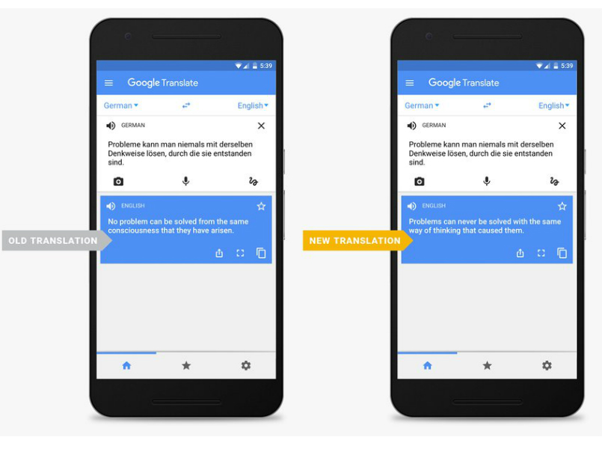
A brief history of AI milestones
2002 — Amazon replaces human product recommendation agents with an automated system
2007 — Google launches Translate, a machine translation service.
Old translation
New translation

Slide 27
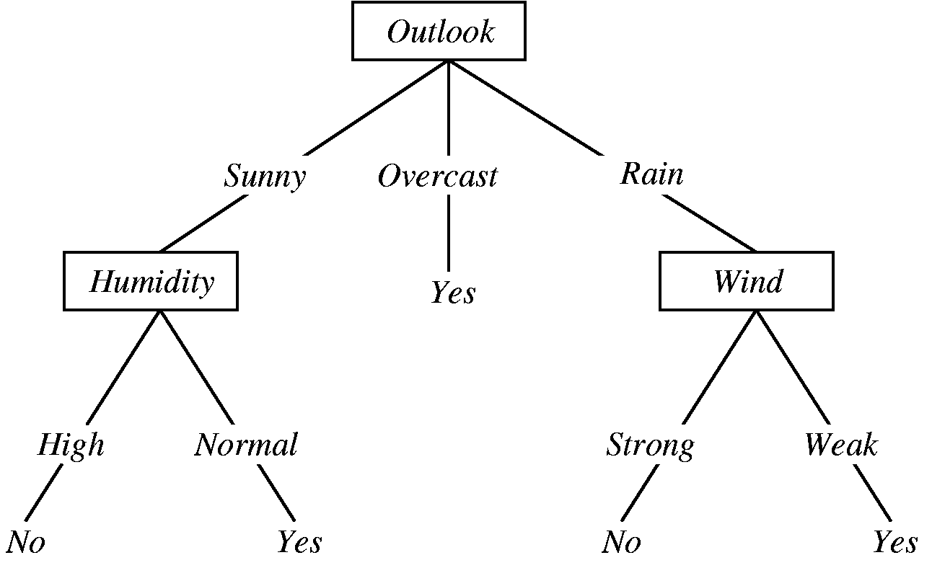
A brief history of AI milestones
2000-2010s—decision trees, random forests, and gradient boosting machines
Decision trees are flowchart-like structures that let you classify input data points or predict output values given inputs
They’re easy to visualize and interpret
Random Forest involves building a large number of specialized decision trees and then ensembling their outputs
2014: A gradient boosting machine, much like a random forest, is a machine-learning technique based on ensembling weak prediction models, generally decision trees. It uses gradient boosting, a way to improve any machine-learning model by iteratively training new models that specialize in addressing the weak points of the previous models.
Applied to decision trees, the use of the gradient boosting technique results in models that strictly outperform random forests most of the time, while having similar properties.
It may be one of the best, if not the best, algorithm for dealing with nonperceptual (structured) data today.
Decision tree to answer the question “Should we work outside?”
Notes:
Random forests are applicable to a wide range of problems
you could say that they’re almost always the second-best algorithm for any shallow machine-learning task.

Slide 28

A brief history of AI milestones
2006 — Geoffrey Hinton coins the term “deep learning” to refer to an old algorithm (artificial neural networks) with new capabilities that let computers “see” and distinguish objects and text in images and videos
Marked improvement over the next few years in image and speech recognition

Slide 29

A brief history of AI milestones
2011 — IBM’s Watson beats its human competitors at Jeopardy (NLP breakthrough)

Slide 30

A brief history of AI milestones
2012 — Hinton and colleagues at the University of Toronto used deep learning techniques to win state of the art competition for image recognition
The team leveraged the computational power of GPUs
2012 — Google starts to tests driverless cars in Nevada
2013 —Deep learning techniques cut error rate in speech recognition by 25%

Slide 31


A brief history of AI milestones
A team at Google DeepMind used a reinforcement learning system to learn how to play 49 Atari games.
The system was able to achieve human-level performance in a majority of the games (e.g., Breakout)
Though some are still significantly out of reach (e.g., Montezuma’s Revenge)

Slide 32

A brief history of AI milestones
2016 - Google’s artificial intelligence algorithm beats a professional player at the Chinese board game Go, which is considered the world’s most complex board game and is many times harder than chess
Combination of deep learning and “reinforcement learning” used

Slide 33




A brief history of AI milestones
2017 - Medical diagnosis: machine vision outperforming ophthalmologist and dermatologists for diabetic retinopathy and skin cancer diagnosis
Using Inception v3 the network machine vision model
You will be using Inception v3 in this paper

Slide 34

A brief history of AI milestones
2018 – Researchers at OpenAI create a bot which beats the world’s top professionals at 1v1 matches of Dota 2 under standard tournament rules.
The bot learned the game from scratch by self-play, and does not use imitation learning or tree search.
This is a step towards building AI systems which accomplish well-defined goals in messy, complicated situations involving real humans.

Slide 35




Quantification of technical performance improvement
http://cdn.aiindex.org/2017-report.pdf

Slide 36




Quantification of technical performance improvement
http://cdn.aiindex.org/2017-report.pdf

Slide 37

So, are we drawing closer to artificial general intelligence?
It’s difficult to tell
No good metrics exists to track general intelligence
Computer perception has definitely been quickly converging with human performance (in some cases even surpassing it)
Something significant has definitely happened within the last few years
Whether we are inching closer to artificial general intelligence is a whole different matter
Maybe that’s even the wrong question
Computers will probably not “think” in the way that a human brain does anytime soon
No one is doing research on making AI algorithms that try to seduce/mate with other algorithms, or compete for social status or come up with a creative ad, or to have a sense of purpose in life
Comparing the computational algorithms of a computer to the machinations of the human mind is like comparing apples and oranges (or planes and birds)
Regardless, computers’ abilities to see, understand, and interact with the world around them in a manner that resembles intelligence behavior is growing at a remarkable rate
And as the quantities of data we produce continue to grow, the hardware speed increases and theoretical breakthroughs are discovered, so might our computers’ ability to process and analyze that data

Slide 38


In terms of whether humanity will reach artificial general intelligence anytime soon…
There are mainly 2 school of thoughts
Technological progress
Singularity
Technological progress
Complexity break
Time
Time

Slide 39

Since the introduction of hidden units, artiﬁcial neural networks have doubled in size roughly every 2.4 years. At this rate they will reach the same number of human neurons by 2050
But! Biological neurons implement more sophisticated computational functions than artificial neural networks

Slide 40
So, what is Machine Learning?
The process of identifying valid, novel, potentially useful, and ultimately generalizable patterns in data
Algorithms that improve their performance at some task with experience (data)
Machine learning as a new programming paradigm
Role of Statistics
Quantitative analysis of the data
Role of Computer Science: Efficient algorithms and data structures
Representing and evaluating the model
Solve the optimization problem
Carry out inference

Slide 41
Machine Learning in a Nutshell
Every machine learning algorithm has three components:
Representation
(Model re-presentation)
Decision trees
Sets of rules / Logic programs
Graphical models (Bayes/Markov nets)
Neural networks
Support vector machines
Model ensembles
Logistic regression
Linear regression
Etc
Evaluation
(probability and statistical tools)
Accuracy
R²
Precision and recall
Squared error
Likelihood
Posterior probability
Cost / Utility
Margin
Entropy
K-L divergence
Etc
Optimization
(Algorithm)
Combinatorial optimization
E.g.: Greedy search
Convex optimization
E.g.: Gradient descent
Constrained optimization
E.g.: Linear programming
Notes:
Evaluation is A way to measure if the algorithm is doing a good job, to measure the distance between its current output and its expected output. This is used as a feedback signal to adjust the way the algorithm works. This adjustment step is what we call "learning".

Slide 42

The machine learning as a model/function that maps input data X to output predictions y
y = f(x)
Training: given a training set of labeled examples {(x₁,y₁), …, (x_{N},y_{N})}, estimate the prediction function f by minimizing the prediction error on the training set
Testing: apply f to a never before seen test example x and output the predicted value y = f(x)
Output
( prediction)
prediction function
(model)
feature vector
(data)

Slide 43



Functions/models
A function is a mathematical process that uniquely maps the value of one or more variables to the value of another variable

Slide 44

1D Functions examples

Slide 45








Multivariate Functions
$$f\left(x,y\right)=z=x^{2}+y^{2}$$
$$f\left(x,y\right)=z=x^{2}−y^{2}$$
$$z$$
$$y$$
$$x$$

Slide 46

Classification of Machine learning problems
Reinforcement learning

Slide 47



Regression
Given some set of features with corresponding numeric continues output, learn a function to predict the numeric output from the features
y = f(x)
Training data in red
Regression model displayed as a blue line
Price of a second-hand car
price
milage

Slide 48



Classification
Given some set of features with corresponding discrete finite labels, learn a function to predict the label from the features
Breast cancer classification: malignant, benign
credit scoring: (low risk, high risk)
y = f(x)
$x$₂ Age
$x1$ Tumor size

Slide 49


Unsupervised Learning
$$X$$
In unsupervised learning tasks you have training data $X$ but no labels $y$
The objective is to find out coherent groups
x₂
x₁

Slide 50


Clustering Applications: Google News

Slide 51


Cocktail party problem
Microphone #1:
Microphone #2:
Output #1:
Output #2:
Cocktail party problem algorithm one-liner (the power of linear algebra - independent component analysis):
[W,s,v] = svd((repmat(sum(x.*x,1),size(x,1),1).*x)*x');
-Octave/Matlab command

Slide 52





Dimensionality reduction
$$X$$
$$y$$
From a naïve point of view, increasing the number of features should lead to better performance
In practice, the inclusion of more features leads to worse performance (i.e., curse of dimensionality)
Need exponential number of training examples as dimensionality increases
Dimensionality reduction is about reducing the dimensionality of the space
Project the d-dimensional points in X into a k-dimensional space X’ so that k << d
Solve the problem in low dimensions
$$X′$$
$$y$$

Slide 53

Heart rate estimation using a WebCam and dimensionality reduction (ICA)

Slide 54


Reinforcement learning
_{Reinforcement learning}
Reinforcement learning (RL) is an area of machine learning inspired by behaviourist psychology, concerned with how software agents ought to take actions in an environment so as to maximize some notion of cumulative reward.

Slide 55



Deep learning
Representation learning attempts to automatically learn good features or representations
Deep learning algorithms attempt to learn (multiple levels of) representation and an output from raw inputs $x$
Around 2010 deep learning techniques study to outperform other machine learning techniques in many problems
Large amounts of training data
Faster hardware (GPUs) that support vectorised fast computation of linear algebra operations
Effective learning methods

Slide 56





Applications
AI is already quite pervasive. Most people use or interact with AI every day, but seldom recognise it.
Finance: Credit scoring, fraud detection
Security: Face recognition, DNA fingerprinting, Network intrusion detection
Manufacturing: automation, Optimization, troubleshooting, prediction of equipment failure
Medicine: Medical diagnosis, drug Discovery
Web: Search engines, classification of email, Real-time customized ad placements
Logistics: self driving cars, self driving airplanes
Natural Language Processing: sentiment analysis, document summarization, document classification, HCI
Computer Vision: face recognition, image analysis
Handwriting recognition: automatic routing of post letters
Social engineering: Social networks analysis
recommendation engines

Slide 57



My personal favorite machine learning application: Brain computer interfaces
Notes:
A brain computer interface system is obviously composed of many parts (biocompatible hardware, signal processing, data storage, etc.) but machine learning algorithms that carry out inference on input data are a centerpiece of the whole system.

Slide 58



BCI Model Building
Introduction To Modern Brain-Computer Interface Design - Christian Kothe, 2014

Slide 59

First functional Intracortical BCI – Made possible by heavy use of machine learning

Slide 60

Paper Overview
This paper will not go in depth about the mathematical underpinnings of learning methods
However, it will provide you with the intuition and the know-how necessary to know which existing tools to use for solving specific problems
Role of visualizations
Warning: This might be the most abstract-heavy and cognitively demanding paper in the entire BIT degree

Slide 61

Roug Course Content and Calendar

Slide 62
Classroom location and times
BITY3 Stream A IN726 – Data Science and Machine Intelligence
Monday: 15:00-17:00 in D312
Wednesday: 13:00-15:00 in D312

Slide 63
Microsoft Teams Channel
Add yourselves to the course Microsoft Teams channel
IN726 - Machine Intelligence
Place for questions and announcements related to the course
Make sure you check this channel regularly since it will be an official form of communication for the paper
If you do not join the channel, you will miss important announcements
Please use common sense when asking questions
I cannot solve assignment tasks for you
I should not repeat information contained in assignments handouts

Slide 64
Fetching Course content
Course content will be made available on I: drive or private GitHub
I:\COURSES\ITP\BITY3\IN726-dsmi
If you want to use the GitHub repository for fetching course content, send me your GitHub username via personal message in Microsoft Teams
Complete course directive on
I: drive
Private GitHub repo: https://github.com/OPClasses2/IN726-dsmi

Slide 65
Grading
Assessment Activity | Weighting
Assignment 1 | 25%
Exam 1 | 25%
Assignment 2 | 25%
Exam 2 | 25%
+ a few bonus points opportunities

Slide 66

Bonus points opportunities
Up to 5% on top of total course grade
You can still get 100% on the paper without a single bonus point
That is, if your average grade in the assignments and exams is 78 and your bonus points grade is 80, your final course grade will be bump up to $78+0.05×80=78+4=82$
i.e. from B+ to A-
There will be 2 opportunities for bonus points scattered throughout the semester
Ethical issues debate 1
Ethical issues debate 2
The grading scale for the 2 bonus points opportunities will be
0%,50%,80%,100%

Slide 67
Office hours
Wednesday 15:00-17:00
No appointment needed
You can also drop by my office at any other time
But try to schedule a meeting beforehand, to make sure I am in the office

Slide 68


Final remarks
Good luck with the course
I hope you find it useful
I'll do my best in trying to be a good instructor
No matter how good I do my job, you still play the central role in the learning process
I expect that you put a fair amount of effort into the course
Previous experience suggests that showing up to class and being engaged in practicals/labs will be an important predictor of course success

Slide 69
Take home message
We are drowning in the deluge of data being collected world-wide
Considerable potential exists in transforming that data into useful knowledge
Even though a lot of claims about AI are overhyped, something significant has happened within the last decade
Improved performance of machine learning over time
Automation has happened, is happening and it will continue to happen
There is economic demand for automation
This will have positive and negative implications for humanity
Regardless of how the future turns out, it should be good for your career to be at least familiarized with the topic of machine intelligence

Slide 70



The implications of progress in learning algorithms: Software 2.0
Neural networks might represent the beginning of a fundamental shift in how we write software.
They are Software 2.0.
The “classical stack” of Software 1.0 is what we’re all familiar with —
It consists of explicit instructions to the computer written by a programmer.
By writing each line of code, the programmer identifies a specific point in program space with some desirable behavior.
A trained neural network with specific weights is a computer program
An algorithm
But this type of software, Software 2.0, is expressed in much more abstract, human unfriendly language, such as the weights of a connection in the neural network.
No human is involved in writing this code because there are a lot of weights (typical networks might have millions), and coding directly in weights is kind of hard
With software 2.0 our approach is to specify some goal on the behavior of a desirable program (e.g., “satisfy a dataset of input output pairs of examples”, or “win a game of Go”), write a rough skeleton of the code (e.g. a neural net architecture), that identifies a subset of program space to search (with gradient descent), and use the computational resources and data about the problem to search this space for a program that works.

Slide 71




Neural Net Building Working Code From Website Screenshots
Turning design mockups into code with deep learning: https://github.com/emilwallner/Screenshot-to-code-in-Keras
Notes:
https://blog.floydhub.com/turning-design-mockups-into-code-with-deep-learning/

Slide 72
Practical
Familiarization with Python
Important if you are not confident in Python
Familiarization with Python notebooks

